Slide 1
Perancangan Sistem Pemrograman
Class Diagram to Database Design

Slide 2
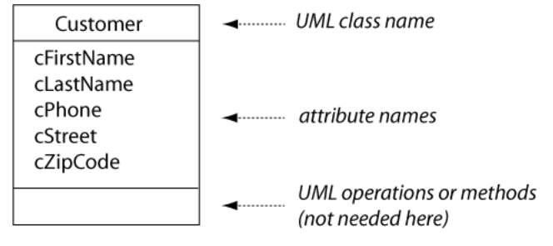
Class Diagram

Slide 3
Relation scheme
In an OO programming language, each class is instantiated with objects of that class. In building a relational database, each class is first translated into a relational model scheme.

Slide 4
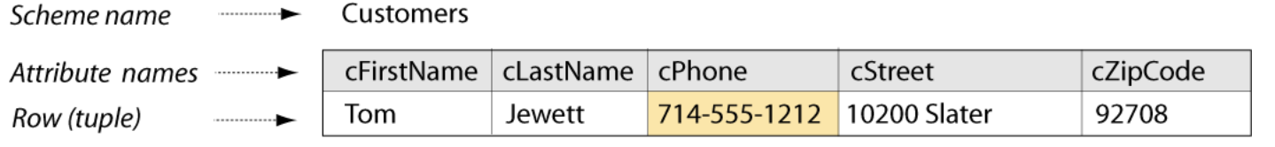
Representing Data in Rows
Each real-world individual of a class (for example, each customer who does business with our enterprise) is represented by a row of information in a database table. The row is defined in the relational model as a tuple that is constructed over a given scheme.

Slide 5
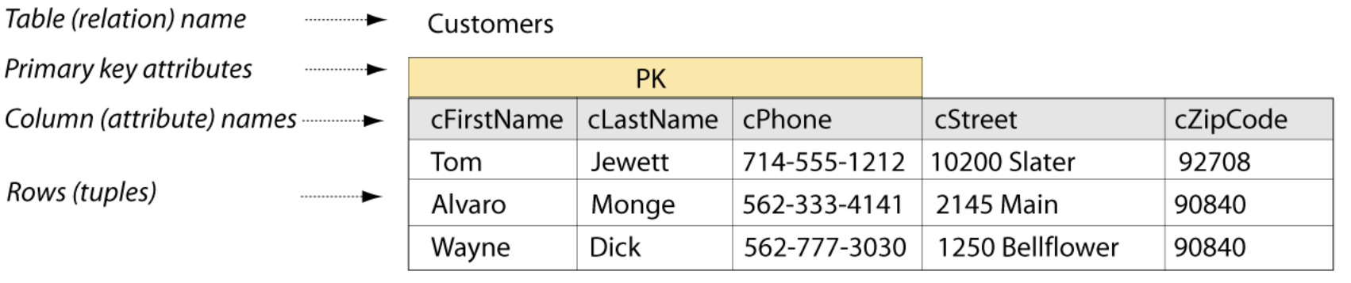
Tables
A database table is simply a collection of zero or more rows. This follows from the relational model definition of a relation as a set of tuples over the same scheme.

Slide 6
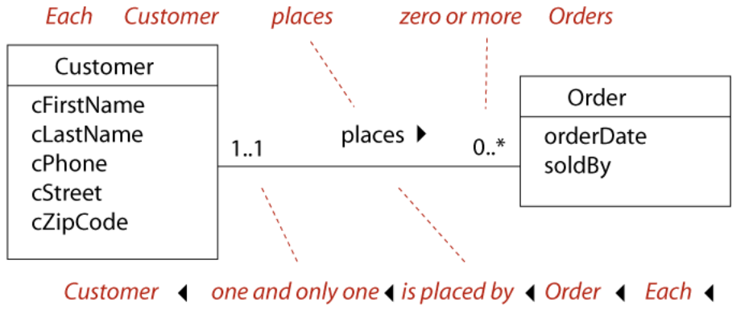
Associations
The UML association (ER term: relationship) is the way that two classes are functionally connected to each other.

Slide 7
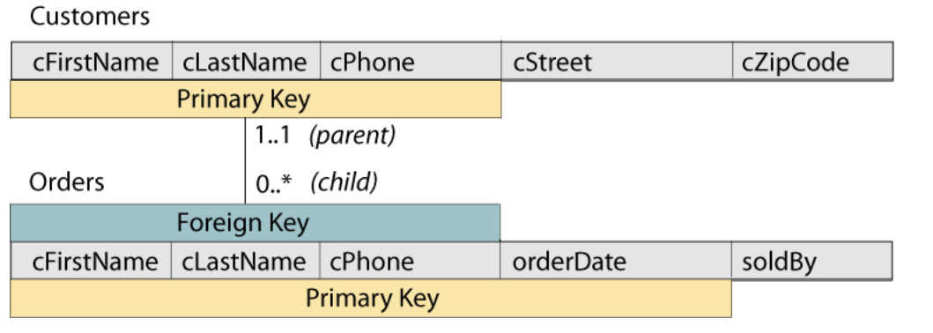
Associations (cont)
We need to represent the association in the database. We need to record which customer placed each order. We do this by copying the PK attributes of the Customer into the Orders scheme. The copied attributes are called a foreign key (FK)

Slide 8
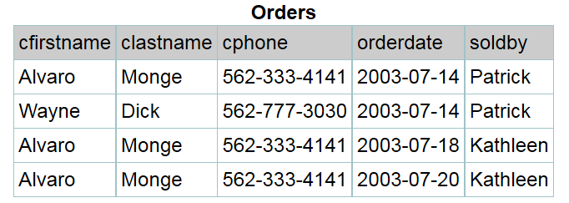
Associations (cont)

Slide 9
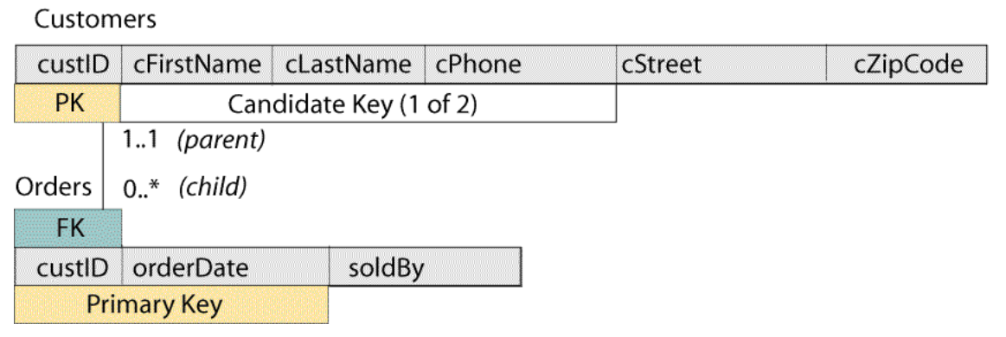
Associations (cont)
Revising the relation scheme

Slide 10
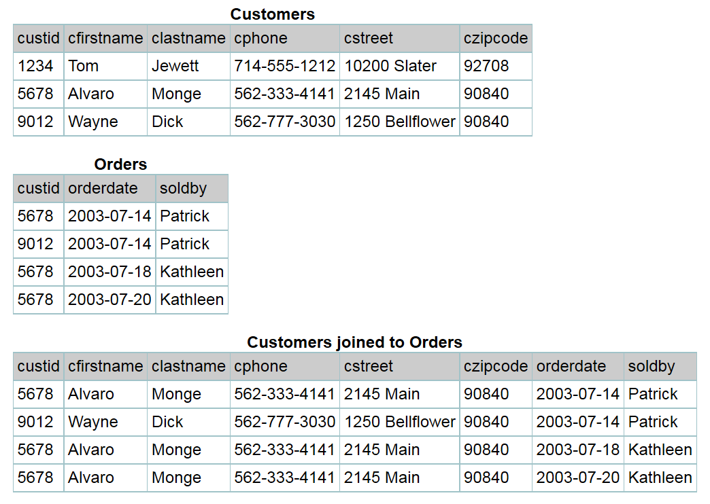
Associations (cont)

Slide 11
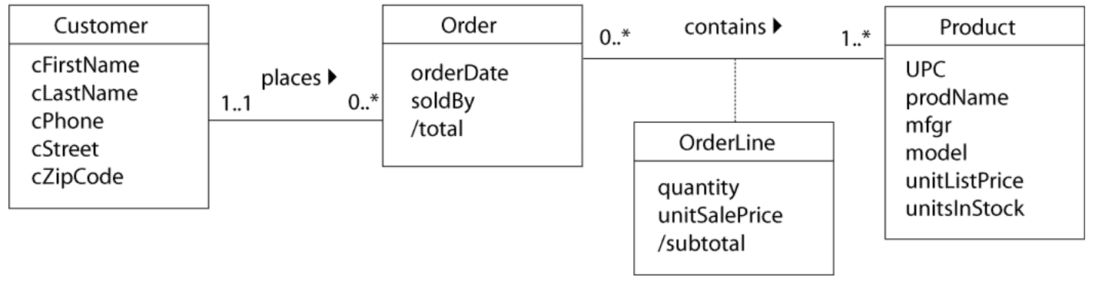
Many to Many

Slide 12
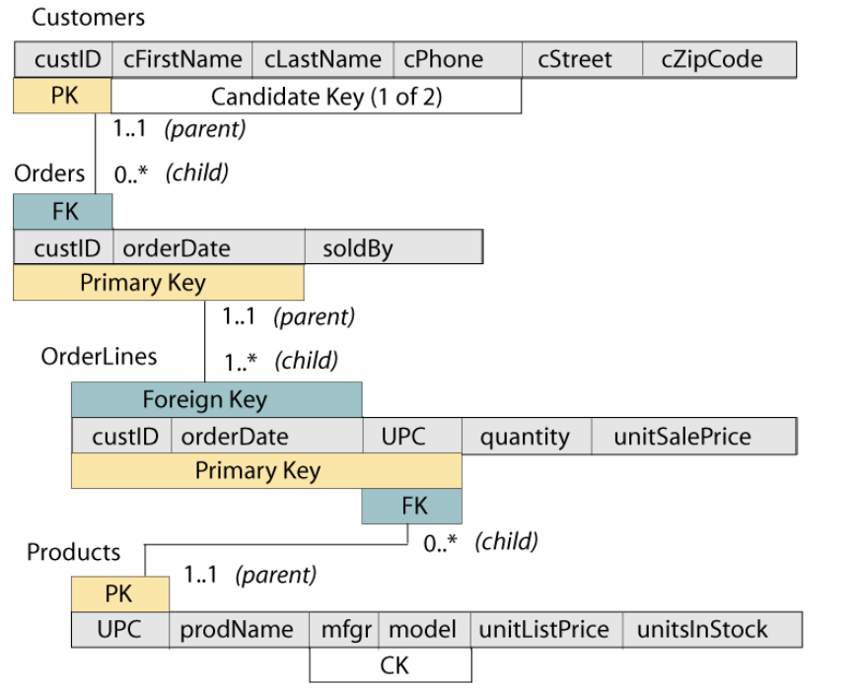
Many to Many (cont)

Slide 13
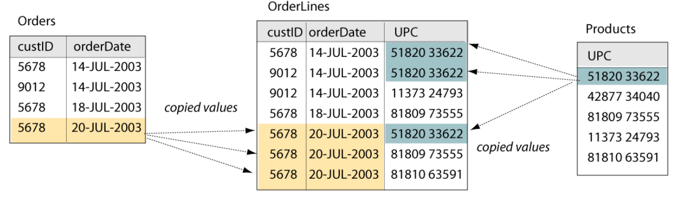
Many to Many (cont)

Slide 14
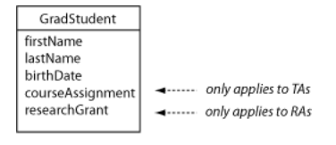
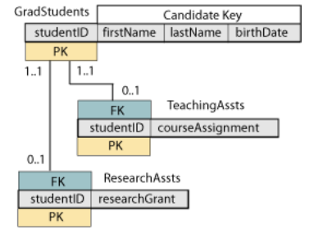
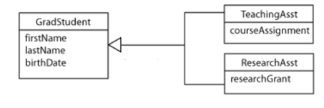
Sub Class – Top Down (Specialization)
For example: we will model the graduate students at a university. Some are employed by the university as teaching associates (TAs); some are employed as research associates (RAs); some are not employed by the university at all.

Slide 15
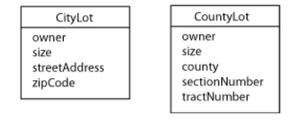
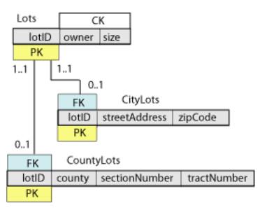
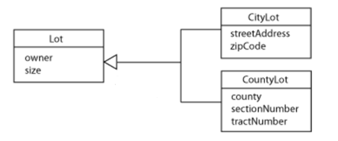
Super Class – Bottom Up (Generalization)

Slide 16
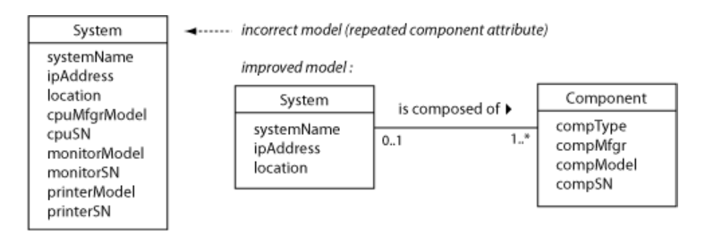
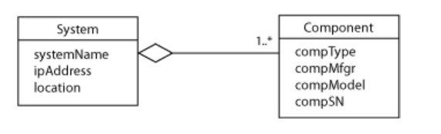
Aggregation
For example: a small business needs to keep track of its computer systems. They want to record information such as model and serial number for each system and its components.

Slide 17
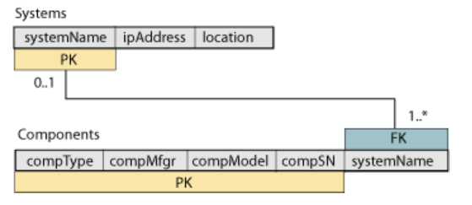
Aggregation (cont)

Slide 18
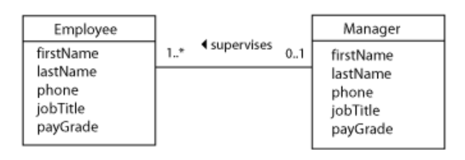
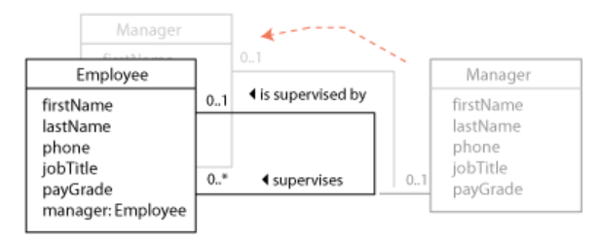
Recursive
Incorrect model
Correct model

Slide 19
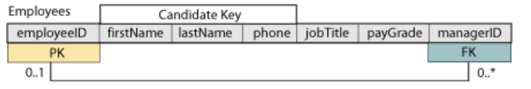
Recursive (cont)

Slide 20
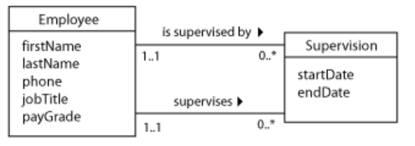
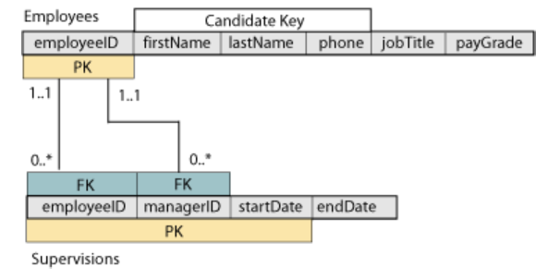
Recursive (cont)
In some project-oriented companies, an employee might work for more than one manager at a time. We also might want to keep a history of the employees’ supervision assignments over time.

